Slide 1


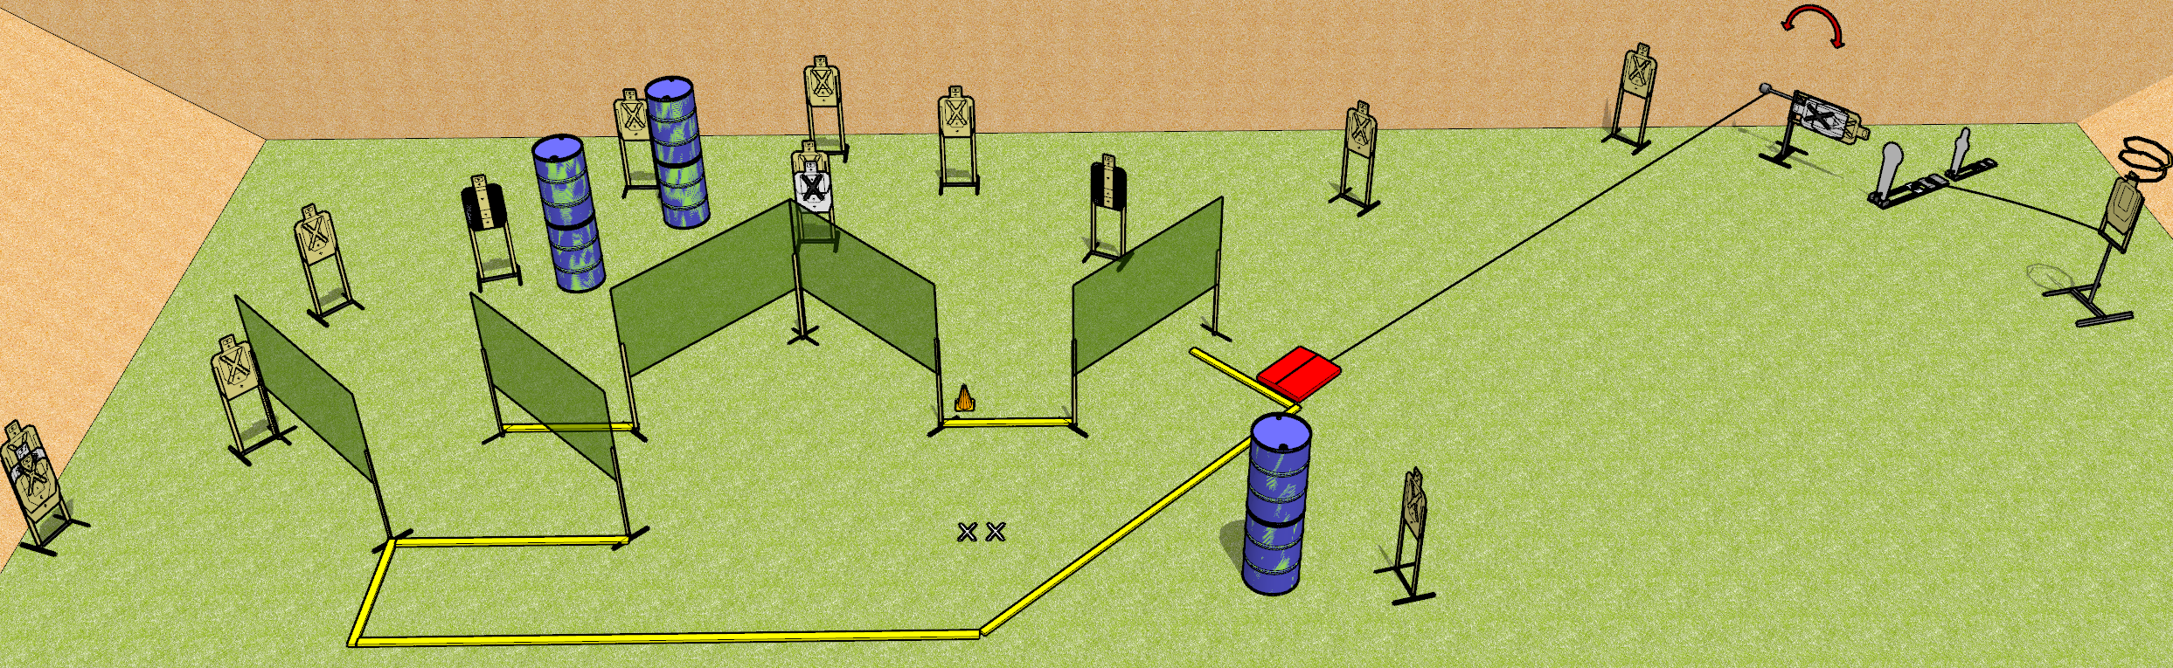
 | Dothan Gun Club – USPSA Match One Mean Mover Course Designer : Drew Coleman
START POSITION : Standing with both feet on X’s, wrists below belt
GUN READY CONDITION : Pistol loaded and holstered. PCC loaded, held with both hands, shouldered, safety on, pointed at orange cone. |  | SCORING: Comstock, 32 rounds TARGETS: 15 paper, 2 Steel SCORED HITS: Best 2 on paper, steel until down START-STOP: Audible, last shot RULES:
STAGE PROCEDURE: Engage targets as they become available from within the fault lines.

Slide 2
One Mean Mover
Written Stage Briefing
One Mean Mover is a 32 round, 160 point, Comstock field course. There are fifteen USPSA targets, one Colt popper, and one mini popper. The best two hits on paper will score, and steel must fall to score. The start signal is audible.
The swinger is activated by the stomp box. The drop turner is activated by the Colt popper, and it is a disappearing target. Please check the activators before walk through and set them the same way every time.
Handgun start position is standing with both feet on X’s, wrists below belt. Handgun is loaded and holstered.
PCC start position is standing with both feet on X’s, muzzle pointed at cone. Loaded carbine is held with both hands, shouldered, safety on.
On start signal, engage targets as they become available from within the shooting area.

